Slide 1
MANAGE YOUR MEMBERSHIP
MyLegion for The American Legion and Sons of the American Legion members.
2025
Notes:
MyLegion is a secure website for American Legion and Sons of the American Legion members. View and manage membership information through MyLegion.org.

Slide 2
ABOUT MYLEGION
Notes:
MyLegion provides The American Legion and Sons of The American Legion members online access to their membership details and management tools. It also gives administrative officer’s tools for membership management and reports.
MyLegion allow members to renew online and set renewal preferences. Administrative officers of posts and squadrons can process membership online through their registered myLegion account.

Slide 3
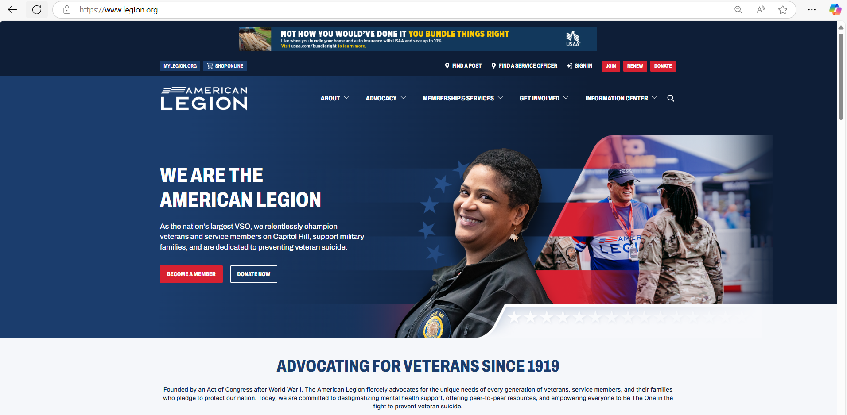

LEGION.ORG
Notes:
Access myLegion through The American Legion National website legion.org. Legion.org is a public site that provides contact information, American Legion available programs, services, and publications for The American Legion American Legion and The American Legion family.
<1> Located at the top of the page is a link for MyLegion.

Slide 4
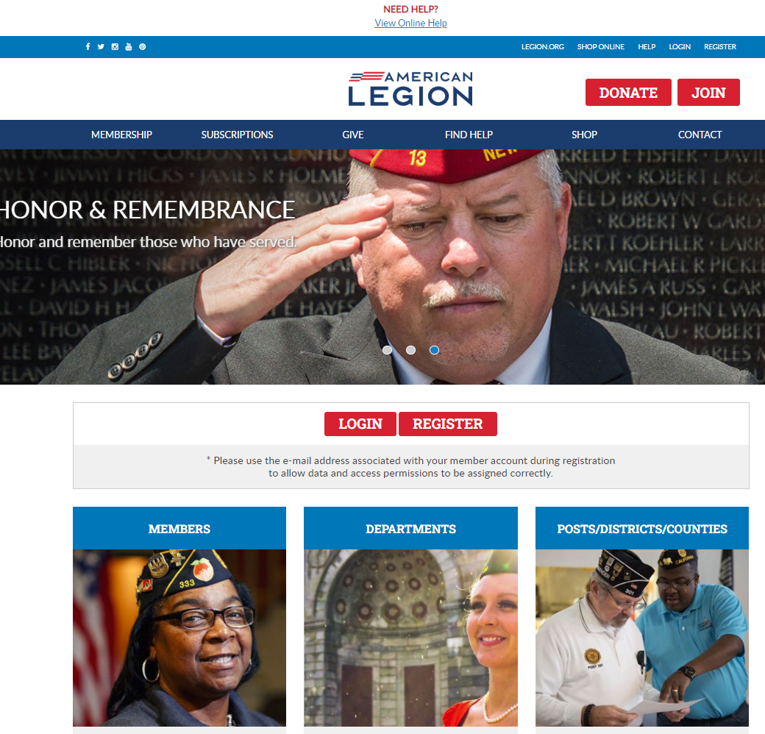
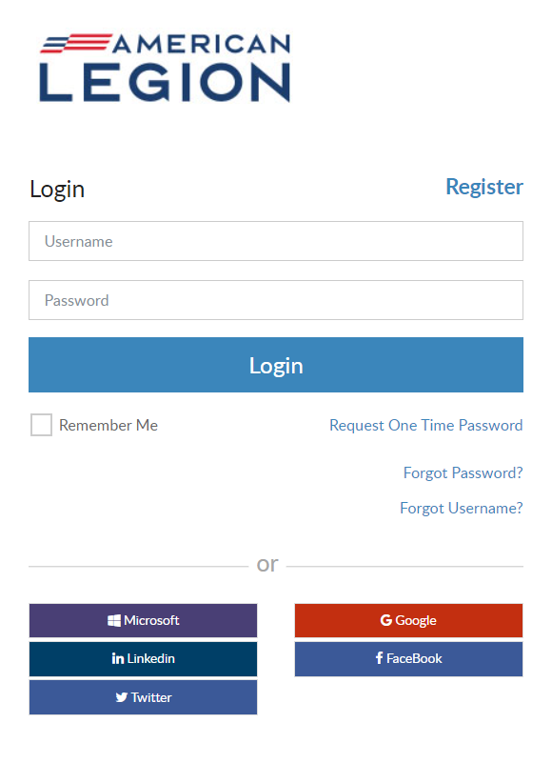

LOGIN
Notes:
Log In with your username and password. If you don’t have an account, click register to create one using the email address on your membership record.

Slide 5
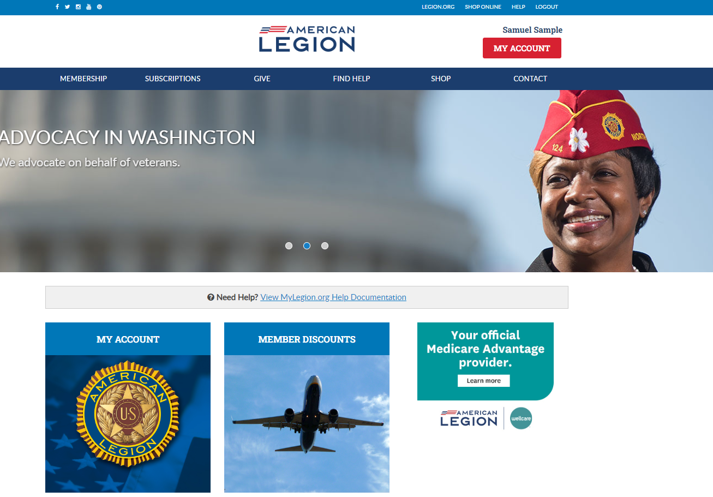
Notes:
Logging into MyLegion opens a Home page that identifies the member’s name located above the MY ACCOUNT button.
From the MyLegion home page you will find menus <1> that include links to membership, subscriptions, donations, help resources, emblem sales and contact information.

Slide 6
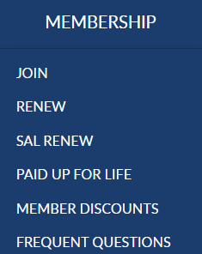
Notes:
Membership links include Join options, Online Renewal, Paid Up for Life information, member discounts, and frequently asked questions about membership eligibility.

Slide 7
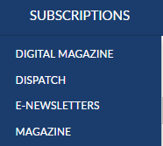
Notes:
Membership in The American Legion includes The American Legion Magazine in digital format from the Subscriptions menu, a link to monthly Dispatch articles and set up options for online E-Newsletters. The Magazine option at the bottom of the list provides a link for non-members to purchase and renew their subscription or purchase additional subscriptions.

Slide 8
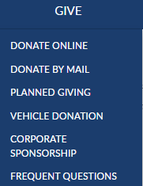
Notes:
Online giving opportunities can be set up through a MyLegion account. The give menu provides information for planned giving, vehicle donations and corporate sponsorships. Questions about giving to American Legion charities are answered in frequent questions.

Slide 9
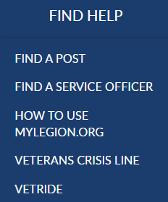
Notes:
Resources helps you find a post or accredited service officers with step-by-step help documentation to assist with MyLegion tools for members and leadership. Links to veteran’s crisis line and Vet Ride are also available.

Slide 10
Notes:
The Shop link navigates to National Emblem Sales and Contact re-directs to legion.org’s National HQ directory.
To view membership details and manage your account click on My Account. <1>
Leadership seeking post and squadron membership will access that information through My Account.

Slide 11
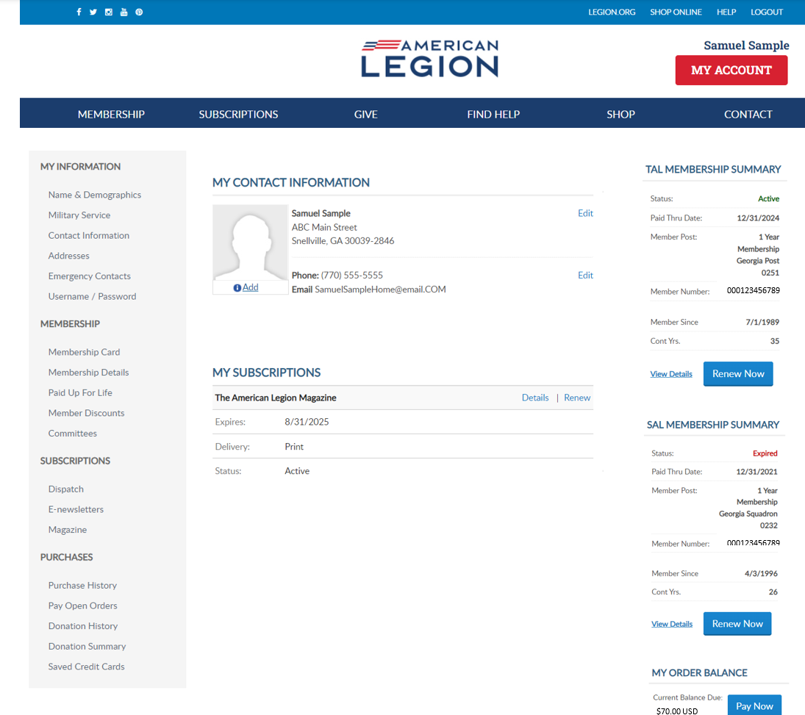
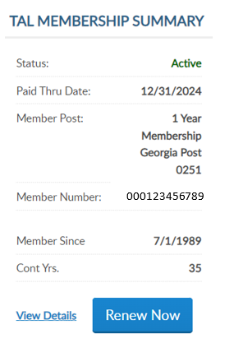
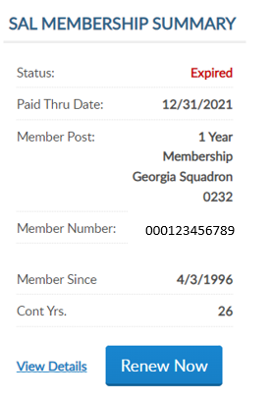
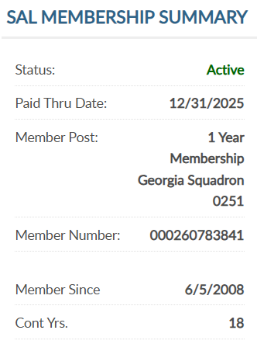
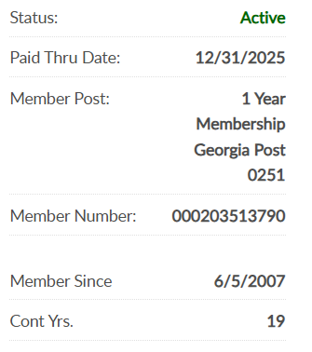
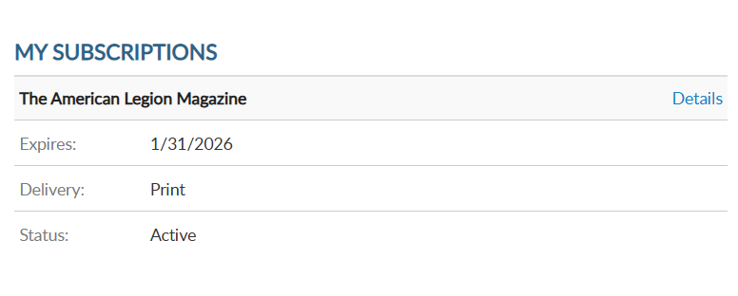
MEMBERSHIP SUMMARIES
000123456789
000123456789
000123456789
000123456789
Notes:
My Account provides membership details.
Summaries for American Legion and Sons of the American Legion membership. <1> It include member status, renewal status, post and squadron number, member ID, join date and continuous years. <2> Members of both The American Legion and SAL are known as dual members and will have the same membership ID#.
When a renewal is available the renew now button will display. To renew, click the renew now button.

Slide 12
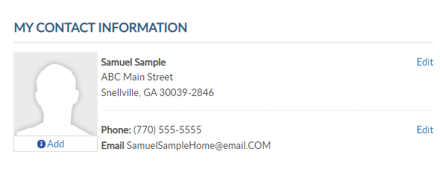
MY CONTACT INFORMATION
Add Picture
Primary Contact Information
Mailing Address
Phone Number
Email Address
000123456789
000123456789
Notes:
Primary contact information is located in the center of the page. <1> This area allows you to add a picture that can be seen by local and state leadership and national headquarters staff. You can also edit your primary mailing address, phone number and email address. You cannot edit your name. Name updates can be made using the left menu option Name and Demographics.

Slide 13
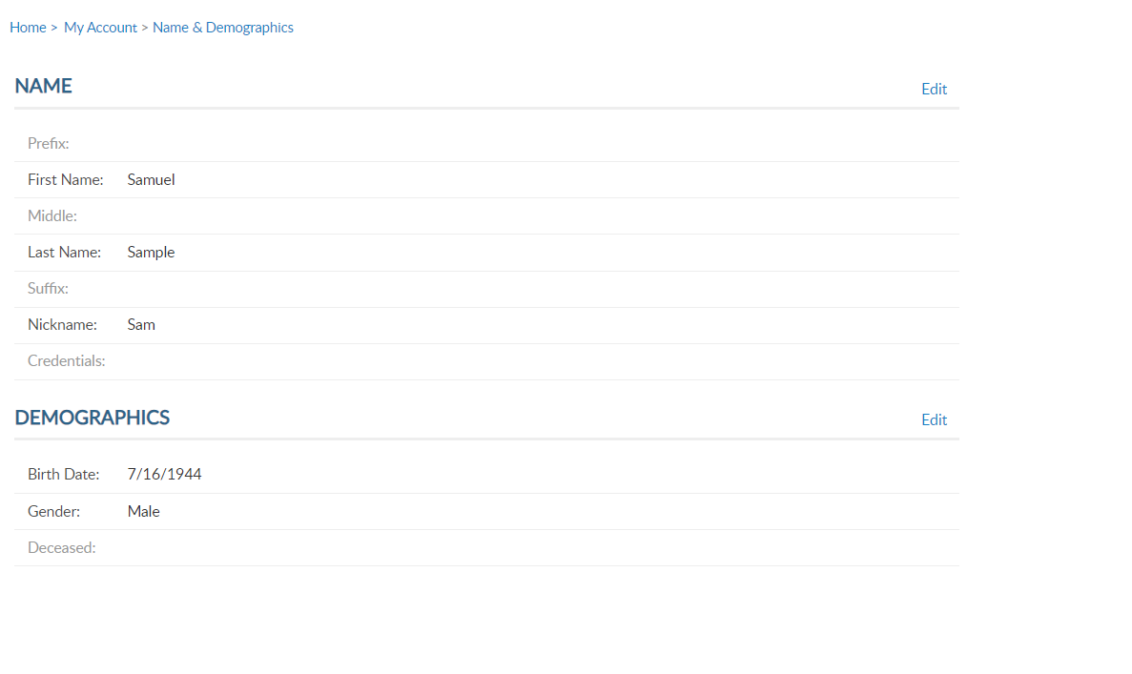
NAME & DEMOGRAPHICS
Name
Demographics
Date of Birth
Gender
Deceased Status
000123456789
000123456789
Notes:
MyLegion allows you to manage your name and demographic information. From the left menu, select Name & Demographics to open the window. <1>
There are 2 sections in this area. Each has an Edit option. The name section includes prefixes, suffixes, nickname and title information. Let’s look at the demographics section. Click edit to the right of demographics.<2>

Slide 14
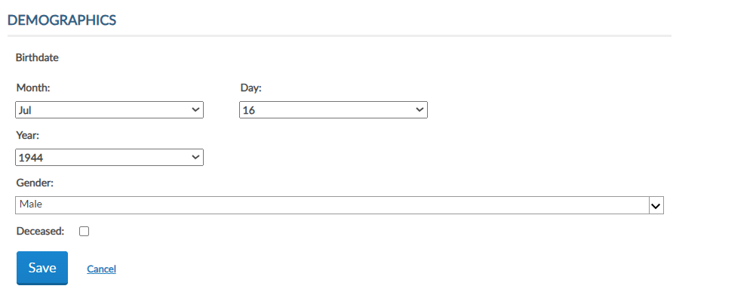
EDIT DEMOGRAPHICS
Notes:
Enter updates and save. Checking the deceased box will change member status to deceased. Deceased status will stop renewal notices, publications and subscriptions and end any committee assignments.

Slide 15
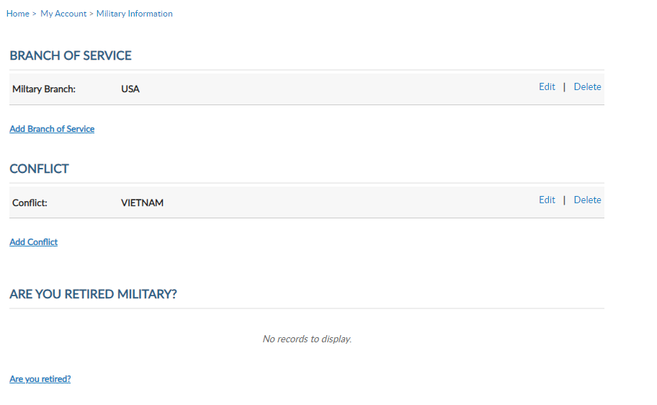
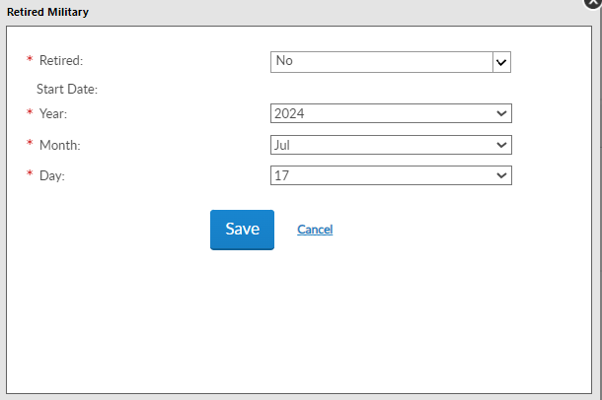
MILITARY SERVICE
Branch of Service
Add/Edit/Delete
Conflict
Add/Edit/Delete
Are You Retired Military?
000123456789
000123456789
Notes:
Military service provides branch of service, conflict and retirement information. Using the Add, Edit or Delete links you can manage this information. Members can list multiple branches and conflicts.

Slide 16
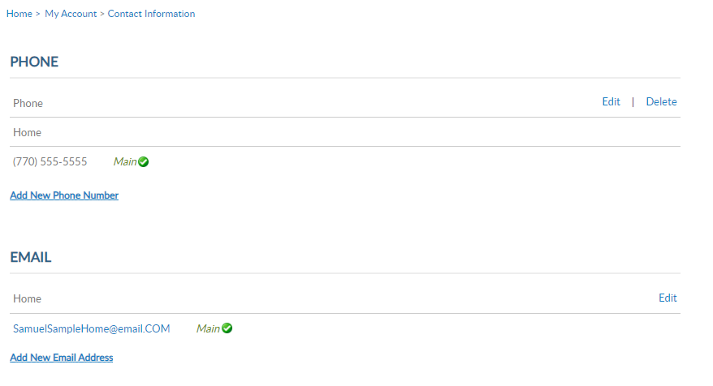
CONTACT INFORMATION
Phone
Add/Edit/Delete
Email Address
Add/Edit
Main Email Required
000123456789
000123456789
Notes:
Primary contact information can be done using edit in My Contact Information. To add or remove a phone number or email address you must use the left menu item Contact Information. <1>
Notice the current contact information is set to main. This is the contact information listed on leadership rosters and reports. Use the add, update and delete links to maintain your contact information.
Only one phone number and email is on file. All phone numbers and emails will display in this window. Notice the email address does not have a delete option. Main email address information cannot be deleted. To update your email address, select the edit button. It is required to have a main email address on your membership record to have a MyLegion account.
NOTE: If you are currently using your email address as your MyLegion username, updating the main email does not update your username. It does update the email associated with you’re your account. Any future username or password requests will be sent to the primary email address on file.

Slide 17
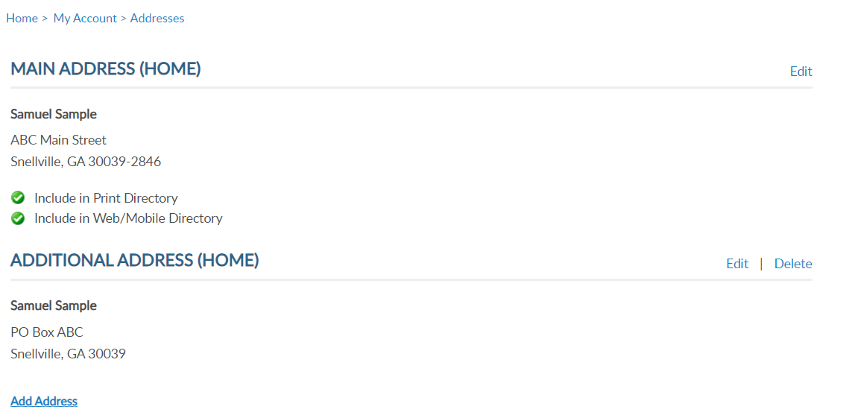
ADDRESSES
Addresses
Add/Edit/Delete
000123456789
000123456789
Notes:
Addresses allows you to add an alternate address and set address preferences. Information set as Main is the primary contact information and cannot be deleted.
Only one main contact can be assigned. You can add alternate address information for subscriptions and committee communications.

Slide 18
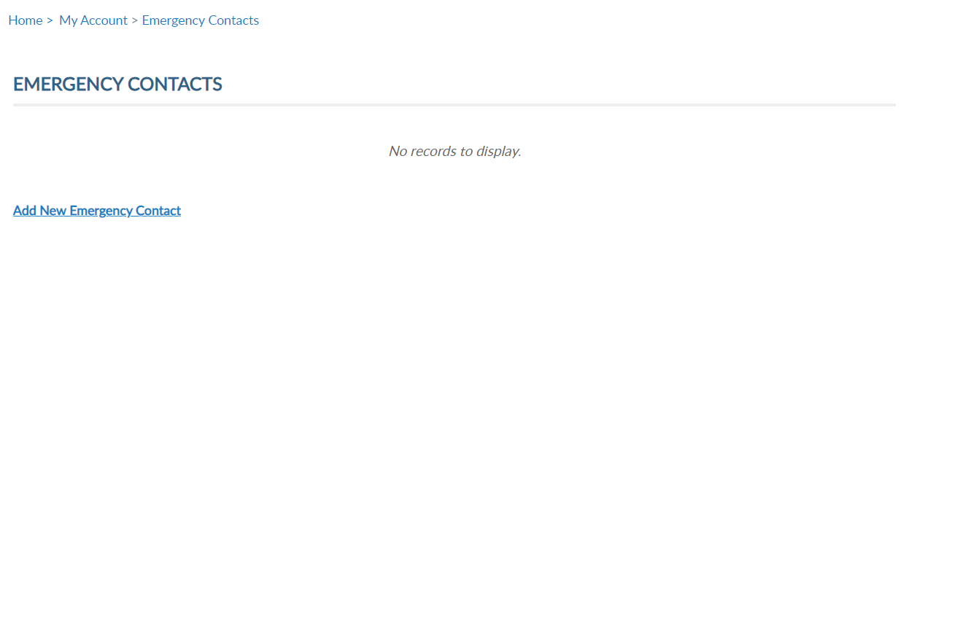
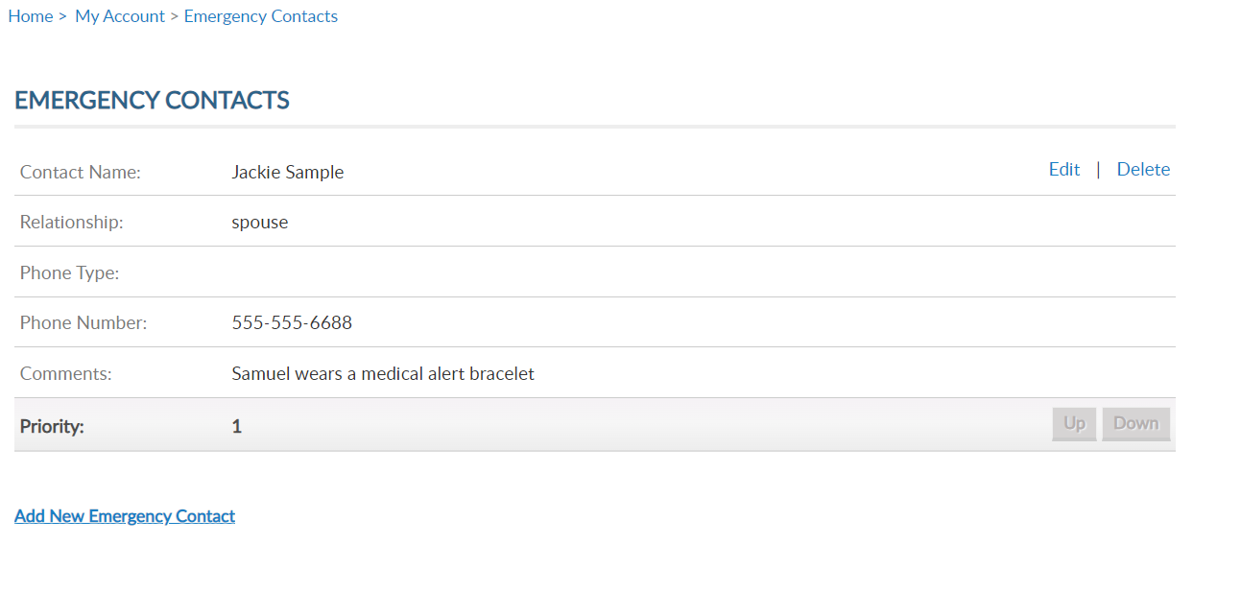
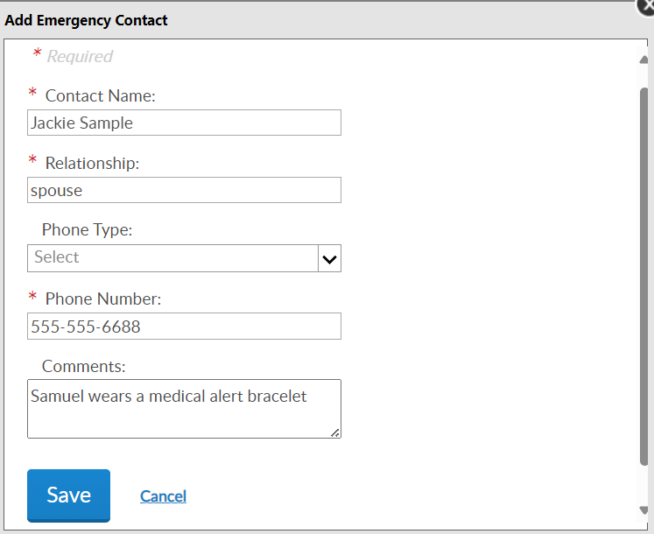
EMERGENCY CONTACTS
Emergency Contacts
Add/Edit/Delete
000123456789
000123456789
Notes:
Emergency contact information. This information can be useful in case of an emergency if you are attending a convention, event, or at your local post. <1>
Add a single contact or multiple contact and designate the priority of who to contact via phone. <2> Click “Add New Emergency Contact”, enter data and “Save.” <3>
You can add multiple contacts or delete/edit as needed.

Slide 19
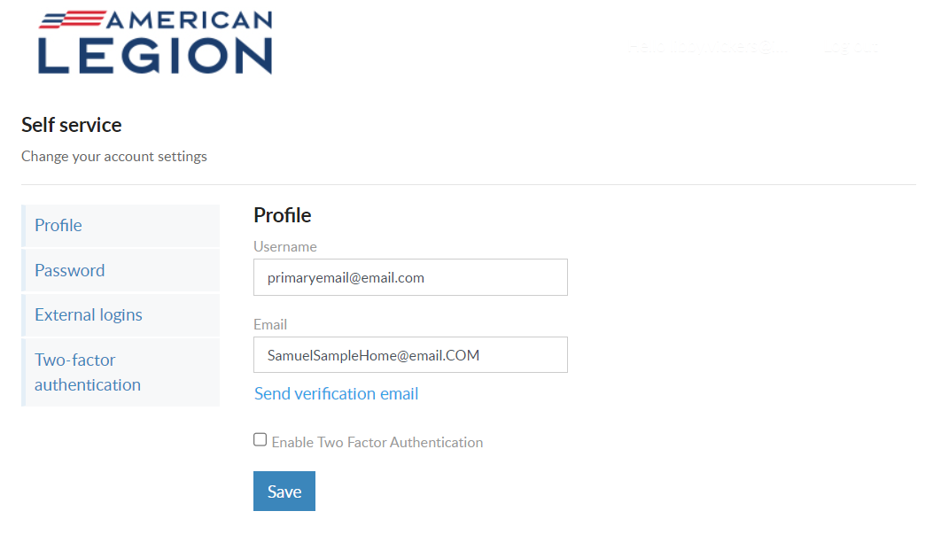
USERNAME & PASSWORD
Profile
Username
Email
2 Factor Authentication
000123456789
000123456789
Notes:
Username/Password allows users to update log in credentials. This link opens a self-service window that shows your current username and primary email associated with your account. <1>
Notice a new tab opens in your browser. When complete with reviewing or updating information, close the tab to return to your MyLegion account.
Your account profile includes username and primary email address. MyLegion accounts are associated with the primary email address on file. Your username does not have to be an email address but is recommended.
The email address listed in the self-service window is the primary, or main email address. Updating the email in Username/Password directs all future forgot username and passwords to this email.
You can also enable or disable 2 factor authentication from this window. Enter new information and Save.

Slide 20
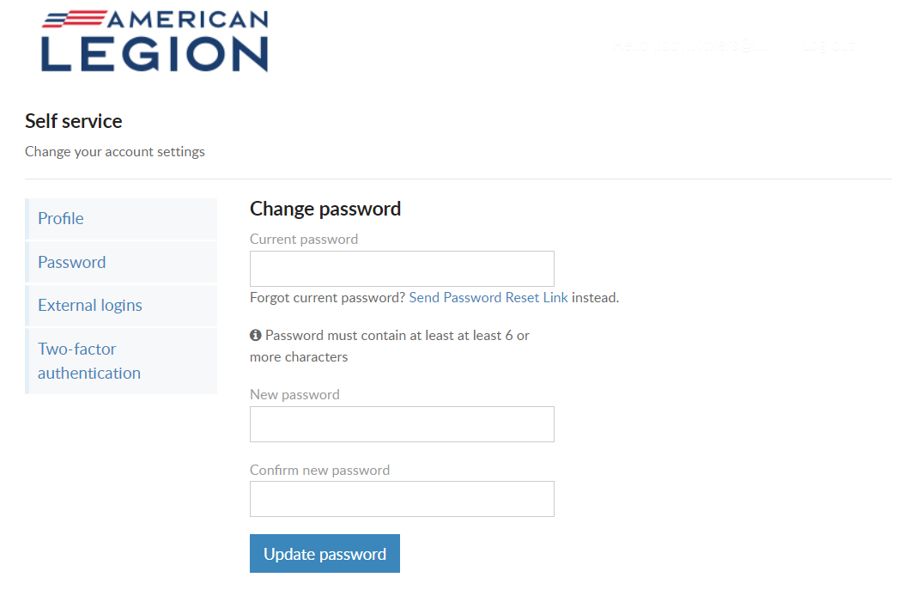
USERNAME & PASSWORD
Password
Current PW required
Must include:
        1 Lowercase Alpha
        1 Uppercase Alpha
        1 Number
        1 Symbol
        8 Character Minimum
Notes:
To update your password in the self-service window you must know your current password. If you have logged in with a saved password and do not know it, you use the “Send Password Reset Link” where a link will be sent to your primary email address.
If you have your current password, enter it with the new password and click ‘Update Password’.
Password requirements include: 1 Uppercase letter, 1 Lowercase letter, 1 Number, 1 symbol, and have an eight-character minimum.

Slide 21
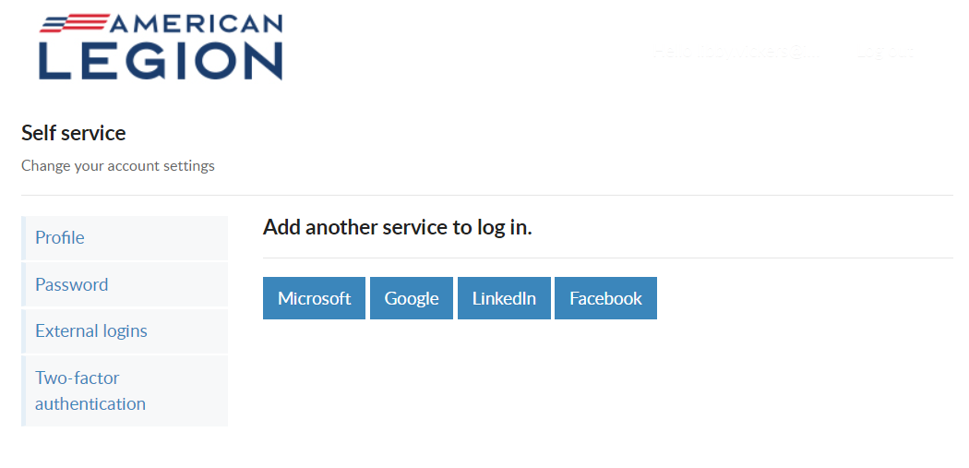
USERNAME & PASSWORD
External Logins
Notes:
Like many other web applications, myLegion users can log in using other online identities as a single sign on process. Allowing fewer passwords to remember.

Slide 22
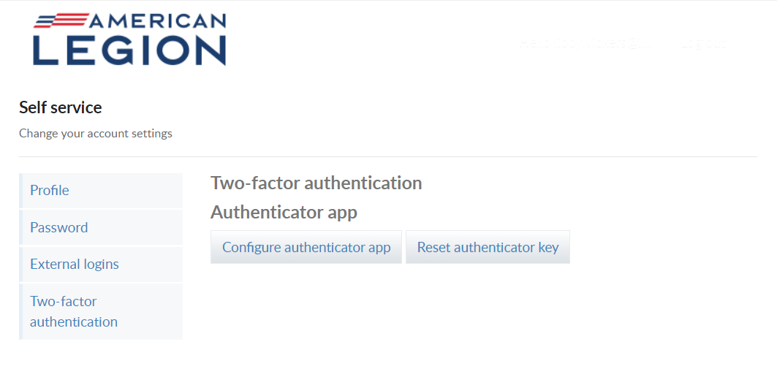
USERNAME & PASSWORD
Two-Factor Authentication
Notes:
Two-factor authentication is an extra layer of security to ensure that you're the only person who can access your account, even if someone knows your password. This extra security measure requires you to verify your identity using a randomized code we'll send you each time you attempt to log in.
If you set up 2 factor authentication, you can disable through self service.

Slide 23
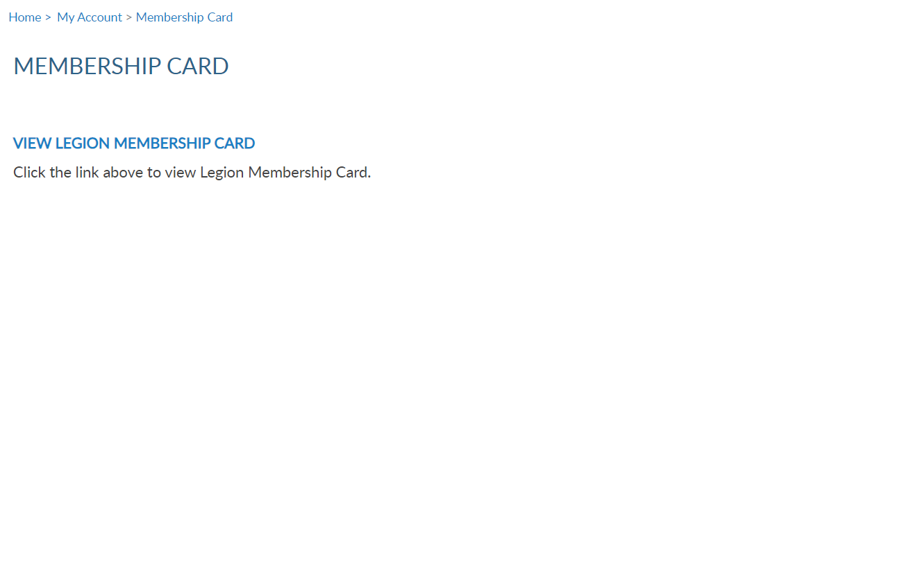
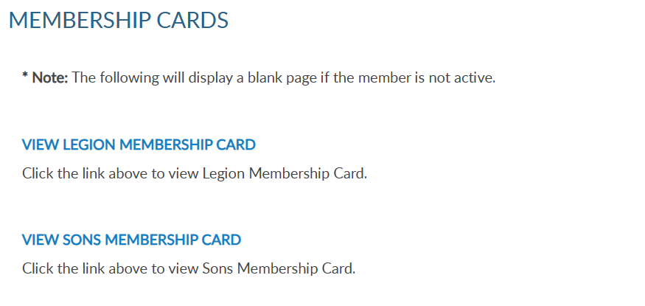
MEMBERSHIP
Membership Cards
LGN and SAL
Current only
000123456789
000123456789
Notes:
To print your membership card, go to Membership Card <1>. Legion and Sons of the American Legion membership cards can be printed. Only current membership cards are available. This member is expired SAL so no link is available. After renewing current dues to the squadron, a SAL link will become available. Click the link for the card to print.

Slide 24
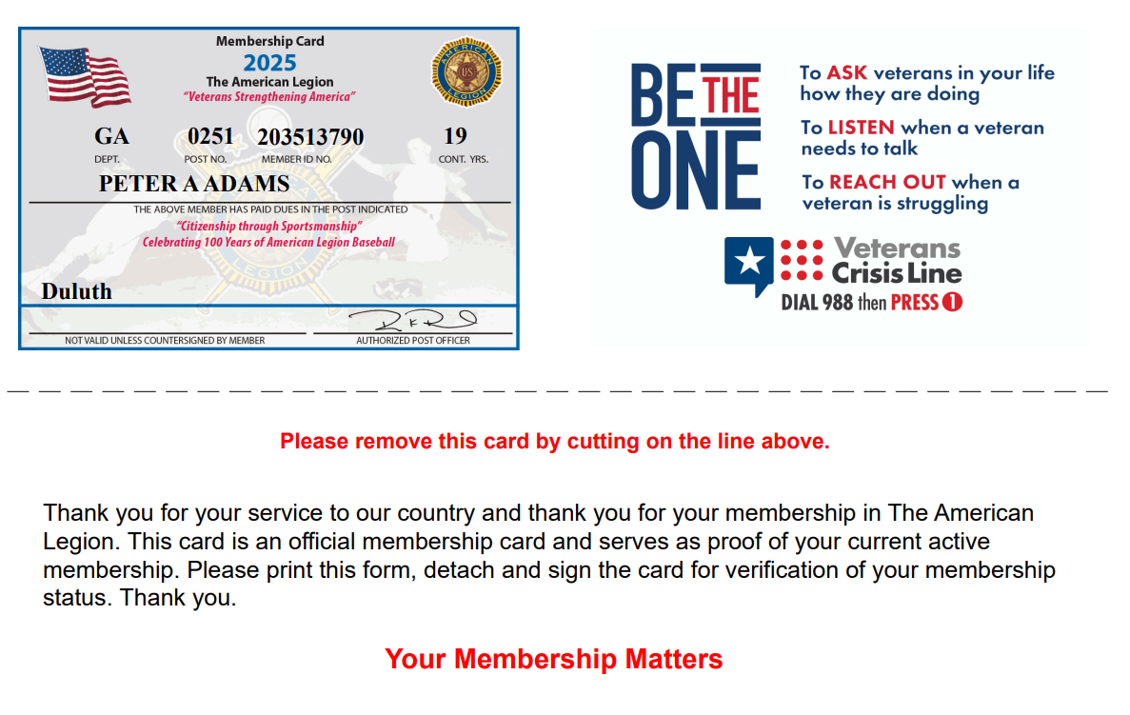
MEMBERSHIP CARDS
123456789
SAMUEL SAMPLE
Notes:
The card is available to print or save from your web browser.

Slide 25
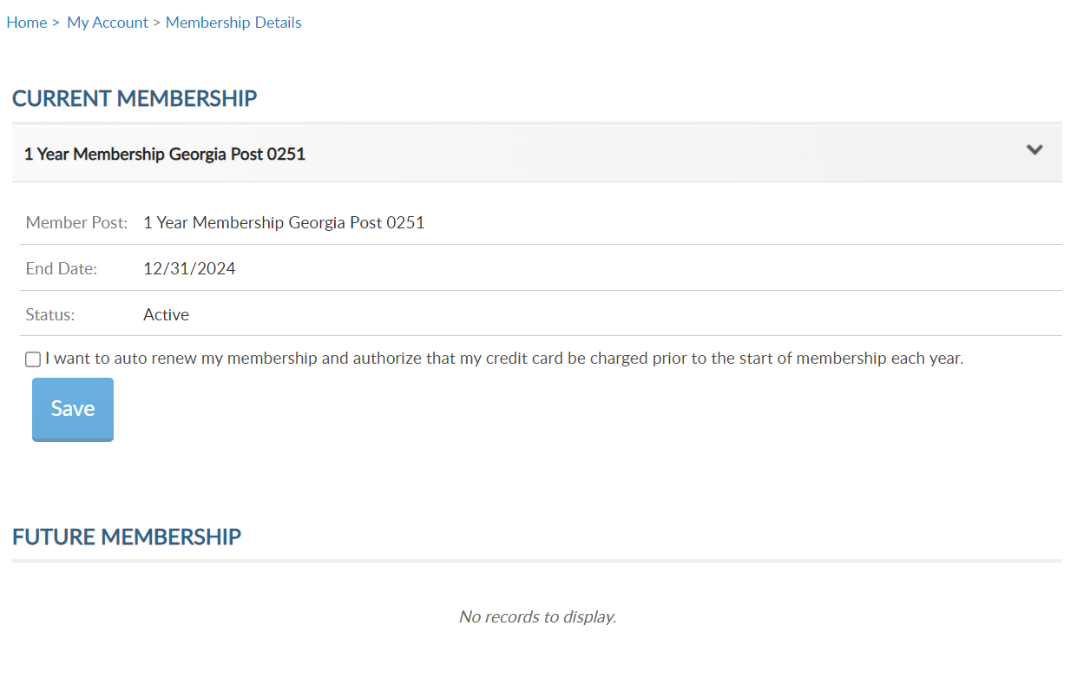
MEMBERSHIP
Membership Details
Renewal type
End date
Status
Auto Renew
Future Memberships
LGN Multi-year renewal
000123456789
12/31/2025
000123456789
Notes:
View membership status and manage automated renewal in Membership Details. <1>
MyLegion allows you to set up auto renewal. Members set up for auto renewal will have their credit cards charged by the 2nd week of July annually and do not receive renewal notices. Auto renew is available for both American Legion and Sons of the American Legion members. You will have to set up each auto renew separate if you are a dual member.
A credit card must be saved prior to setting up auto renew. Credit card information is stored in Saved Credit Cards. <1>

Slide 26
MEMBERSHIP
000123456789
000123456789
Notes:
The Paid Up For Life links provide the application to purchase a paid up for life membership. The application provides a quote to purchase or set up a time payment plan.

Slide 27
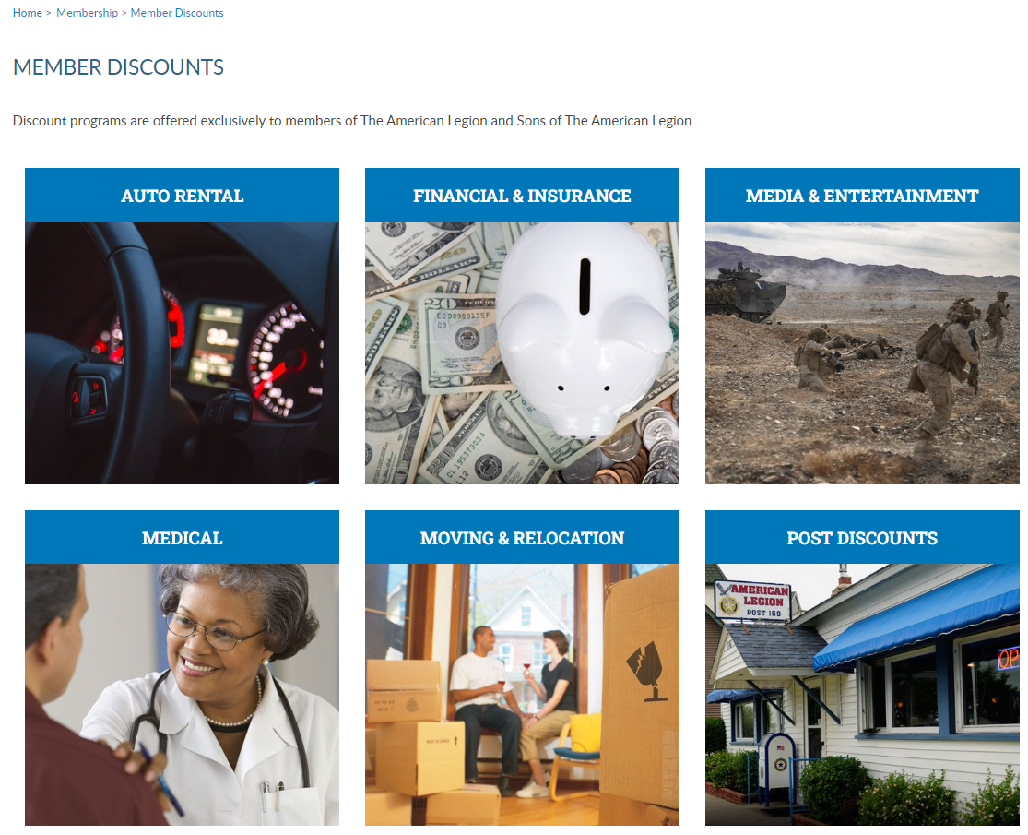
MEMBERSHIP
Member Discounts
Codes & Contacts
Members Only
000123456789
000123456789
Notes:
The American Legion offers exclusive discount programs for members of The American Legion and Sons of the American Legion. Discount provider information and codes are only available to members.
Discount codes are found only when logged into myLegion or legion.org. Select the area of interest to view provider contact information and exclusive discount codes.

Slide 28
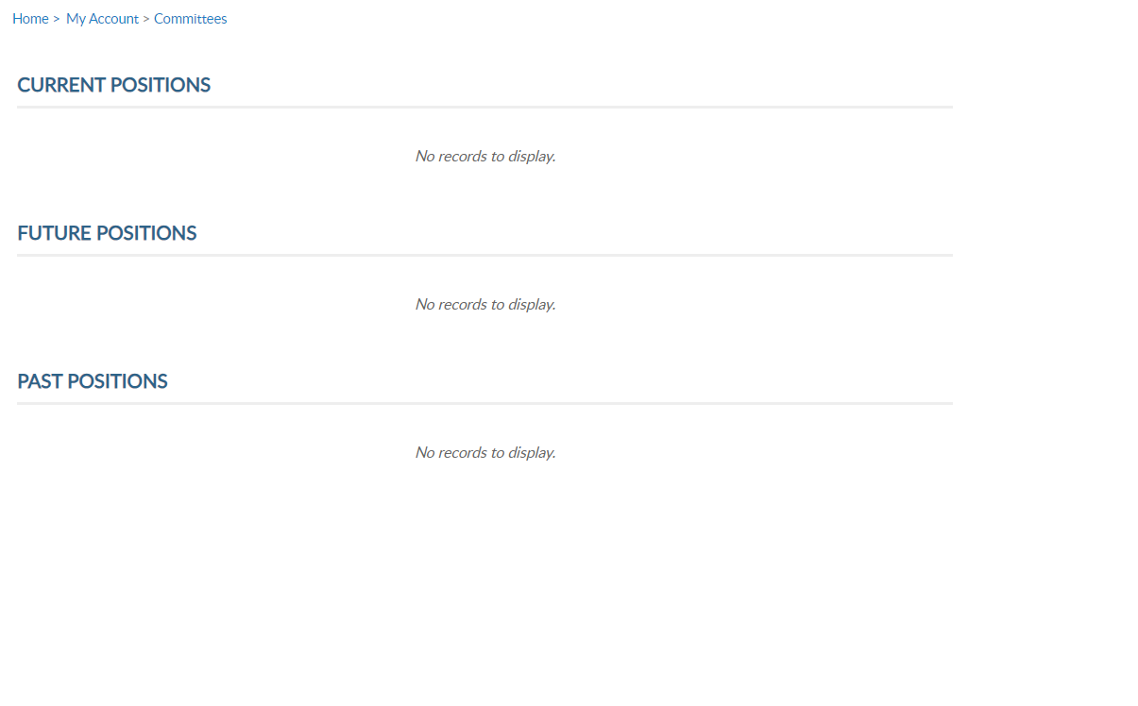
MEMBERSHIP
Committee
Current
Past
Future
000123456789
000123456789
Notes:
Committees list current, future and past positions reported to national headquarters. Missing information regarding your officer history can be clarified through your department headquarters.

Slide 29
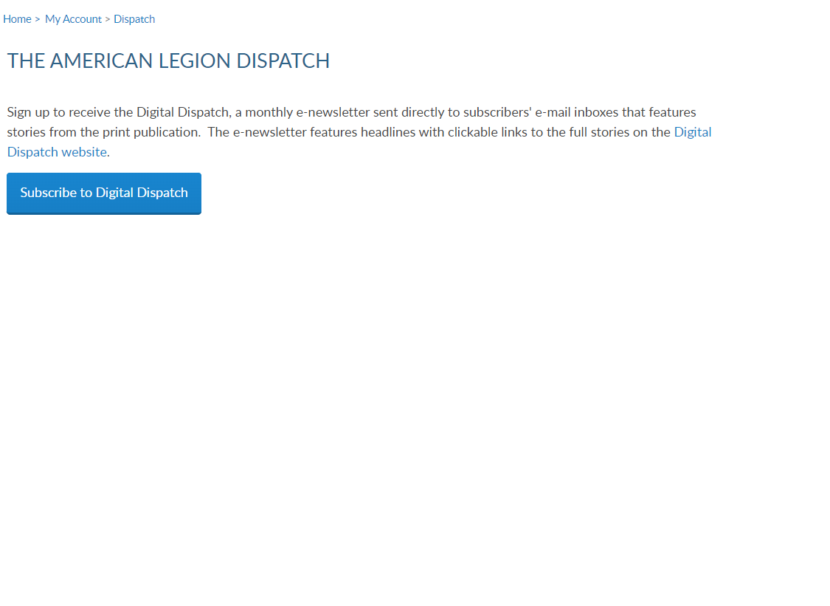
SUBSCRIPTIONS
Dispatch
Digital Only
000123456789
000123456789
Notes:
Dispatch is an American Legion National Headquarters monthly online newsletter that provides post, district and department leaders with news relevant to membership, post activities and national American Legion news.
A monthly Digital Dispatch e-newsletter is sent directly to subscribers’ email inboxes. The e-newsletter features headlines with clickable links to the full stories on the Digital Dispatch web page, www.legion.org/dispatch.

Slide 30
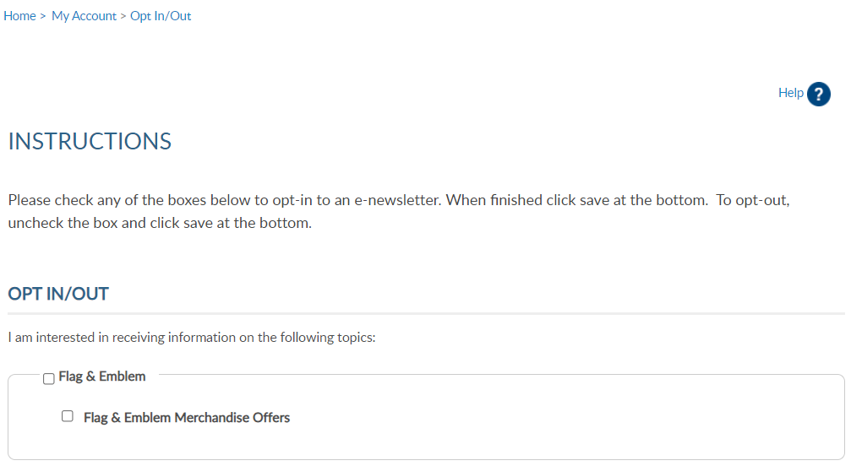
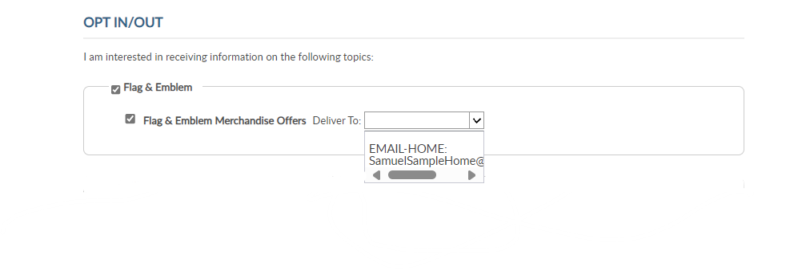
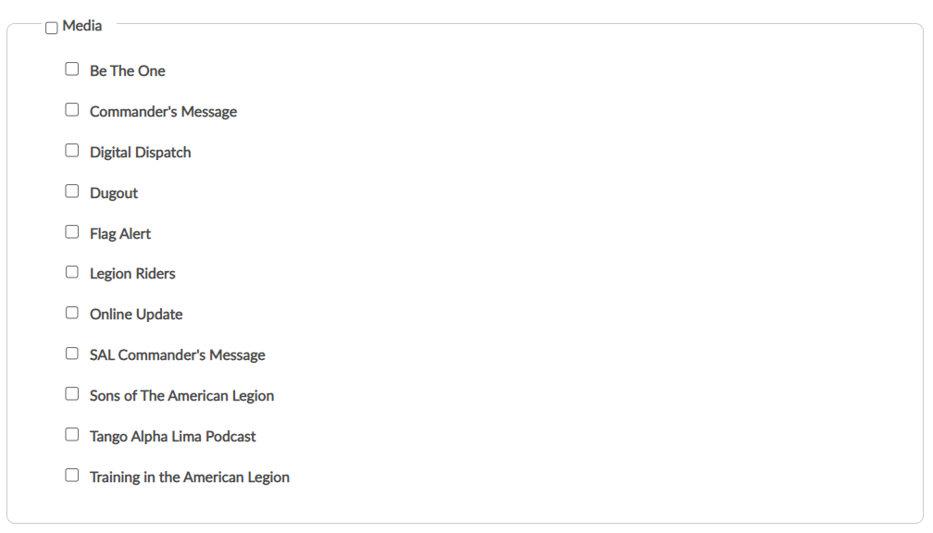
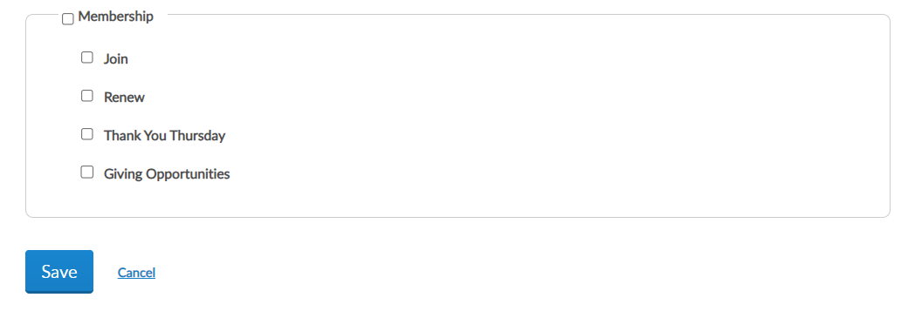
SUBSCRIPTIONS
E-Newsletters
000123456789
000123456789
Notes:
E-newsletters allows you to opt in or out of online subscriptions. <1> There are 3 sections. Flag & Emblem, Media, and <2> Membership.
Check the box to select individual subscriptions. <3> Unless specified these subscriptions will be emailed to the main email address on file.
Once all options are selected, save changes.

Slide 31
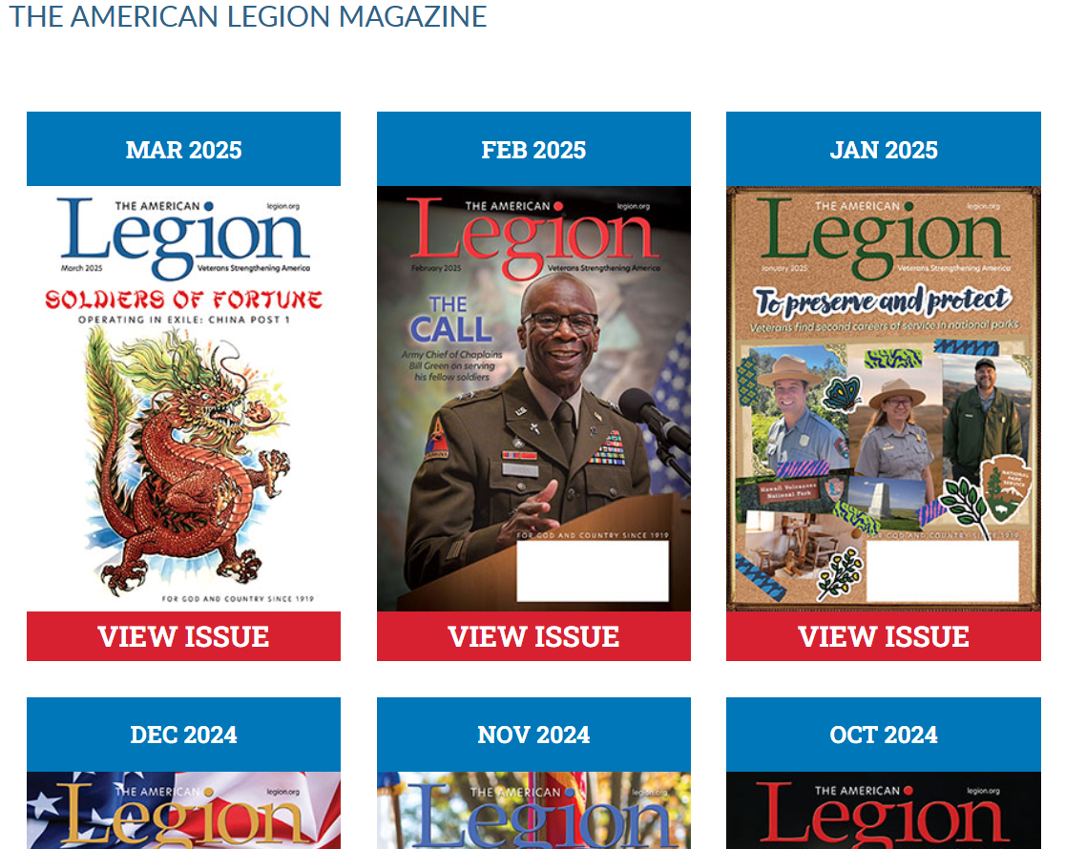
SUBSCRIPTIONS
Magazine
Current and Past Issues
Current Members only
000123456789
000123456789
Notes:
Members receive a 12-month free subscription to The American Legion Magazine. This publication has gone digital. Current and past issues are located your My Account subscriptions menu.
Expired members will receive an Access Denied message. Access to online magazine requires active American Legion, Sons of the American Legion membership, or paid subscription.

Slide 32
PURCHASES
Purchase History
Pay Open Orders
Donation History
Donation Summary
Save Credit Cards
000123456789
000123456789
Notes:
Purchase history shows current open orders and history of payments made for membership, donations and subscriptions. Purchases section allows you to view and pay on open orders using a credit card and manage credit card information.

Slide 33
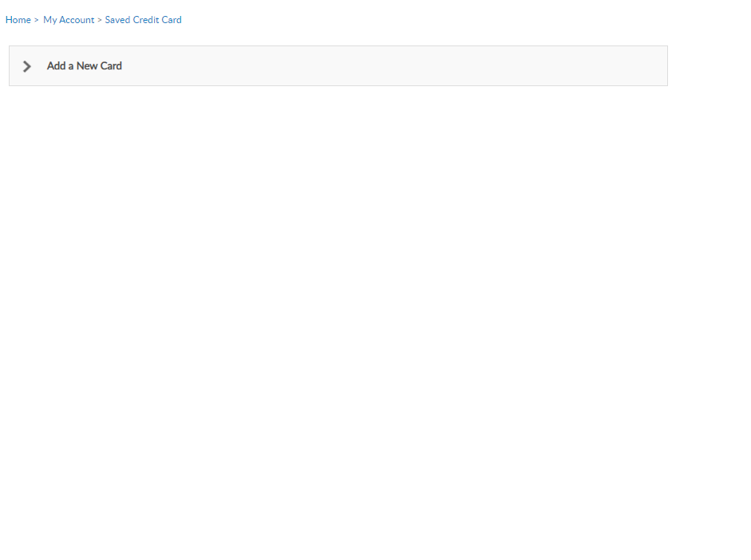
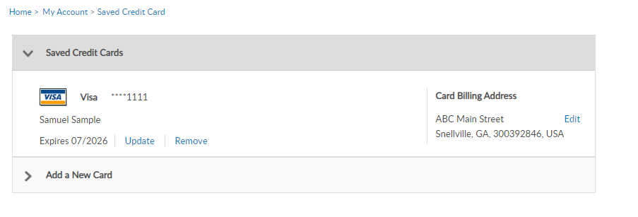
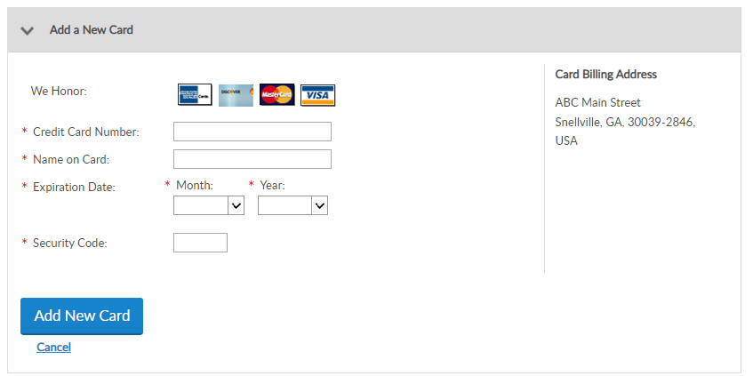
PURCHASES
Save Credit Cards
Add New Card
000123456789
000123456789
Notes:
Members can enter, maintain, and save credit card information for auto renewal, donations, and purchases.
<1> If not card is stored you can add a new card. <2> Go to add New Card, enter card information and Save. <3>
At anytime you can update, remove or add another card.

Slide 34
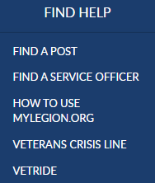
MY ACCOUNT & HELP RESOURCES
000123456789
000123456789
Notes:
Learn more about MyLegion using “Find Help” and go to How to use MyLegion.org.

Slide 35
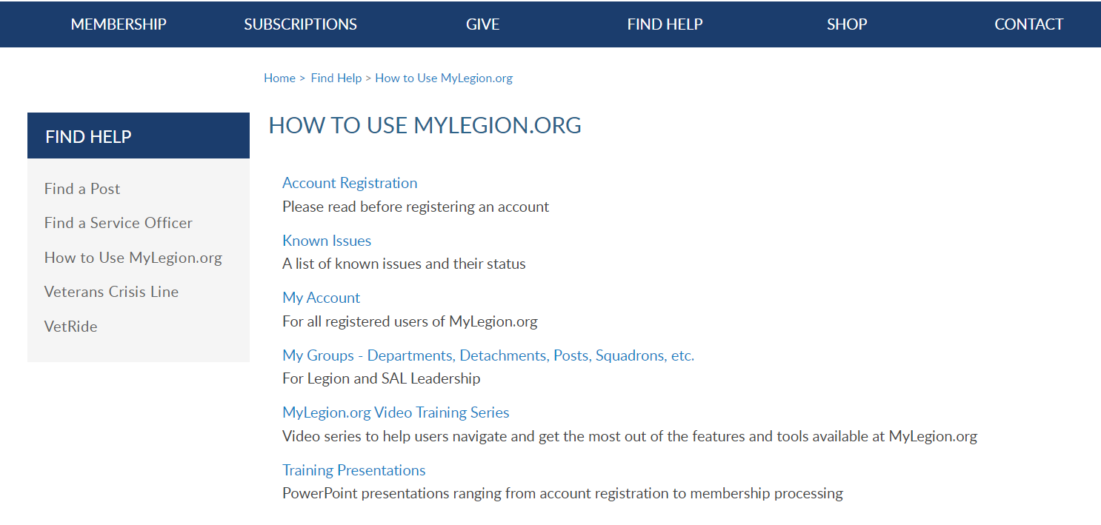
Online Help
Notes:
Step by step instructions, videos and training presentations will assist with how to manage your member account and groups in MyLegion.

Slide 36
Contact your department or national MyLegion support to assist with any questions or help with MyLegion.
MyLegion@legion.org
833.253.9995
Monday – Friday
8:00am – 4:30pm
(Eastern)
Notes:
Contact your department or national MyLegion support to assist with any questions help with MyLegion.

